Slide 1



G H RAISONI INSTITUTE OF ENGINEERING AND TECHNOLOGY, NAGPUR
(Approved by AICTE, New Delhi and Recognized by DTE, Maharashtra)
An Autonomous Institute Affiliated to Rashtrasant Tukadoji Maharaj Nagpur University, Nagpur
Accredited by NAAC with A+ Grade
Department of Science and Technology
Introductory Seminar
On
URBAN SPOTTER
GUIDE:Mr.Anupam Chaube
Name of Projectees
Mr. Charanjot Singh Sivia Mr.Ayush Mandpe
Mr. Amruj Lende Mr.Amritpal Singh Bamrah
Mr. Shivam Deotale Mr. Gagan Bisen
Session 2022-23

Slide 2
Contents
Introduction
Objective of Project
Block Diagram /DFD and ER Diagram
Work done
Result & Discussion
Work plan
Conclusion (Till Date)
References

Slide 3
Introduction
Introducing Urban Spotter, where seamless parking meets modern convenience.Navigating the urban jungle or event crowds has never been easier.
Our platform is your go-to destination for finding,reserving,and managing parking spaces effortlessly.
Navigate the urban landscape effortlessly with our smart parking solutions.Our user-friendly interface lets you reserve parking spaces with ease,ensuring a stress free start to your journey.
Welcome to a world where parking is no longer a hassle- welcome to Urban Spotter.

Slide 4
Objectives
Simplify the parking experience by providing a straightforward and user-friendly platform.
Reduce the time and stress associated with finding parking spaces.
Focus on user satisfaction by ensuring cost structures,secure reservations, and a platform that incorporates user feedback.
Our goal is to provide accessible parking options, including features for individuals with specific requirements,ensuring convenience for all user.

Slide 5
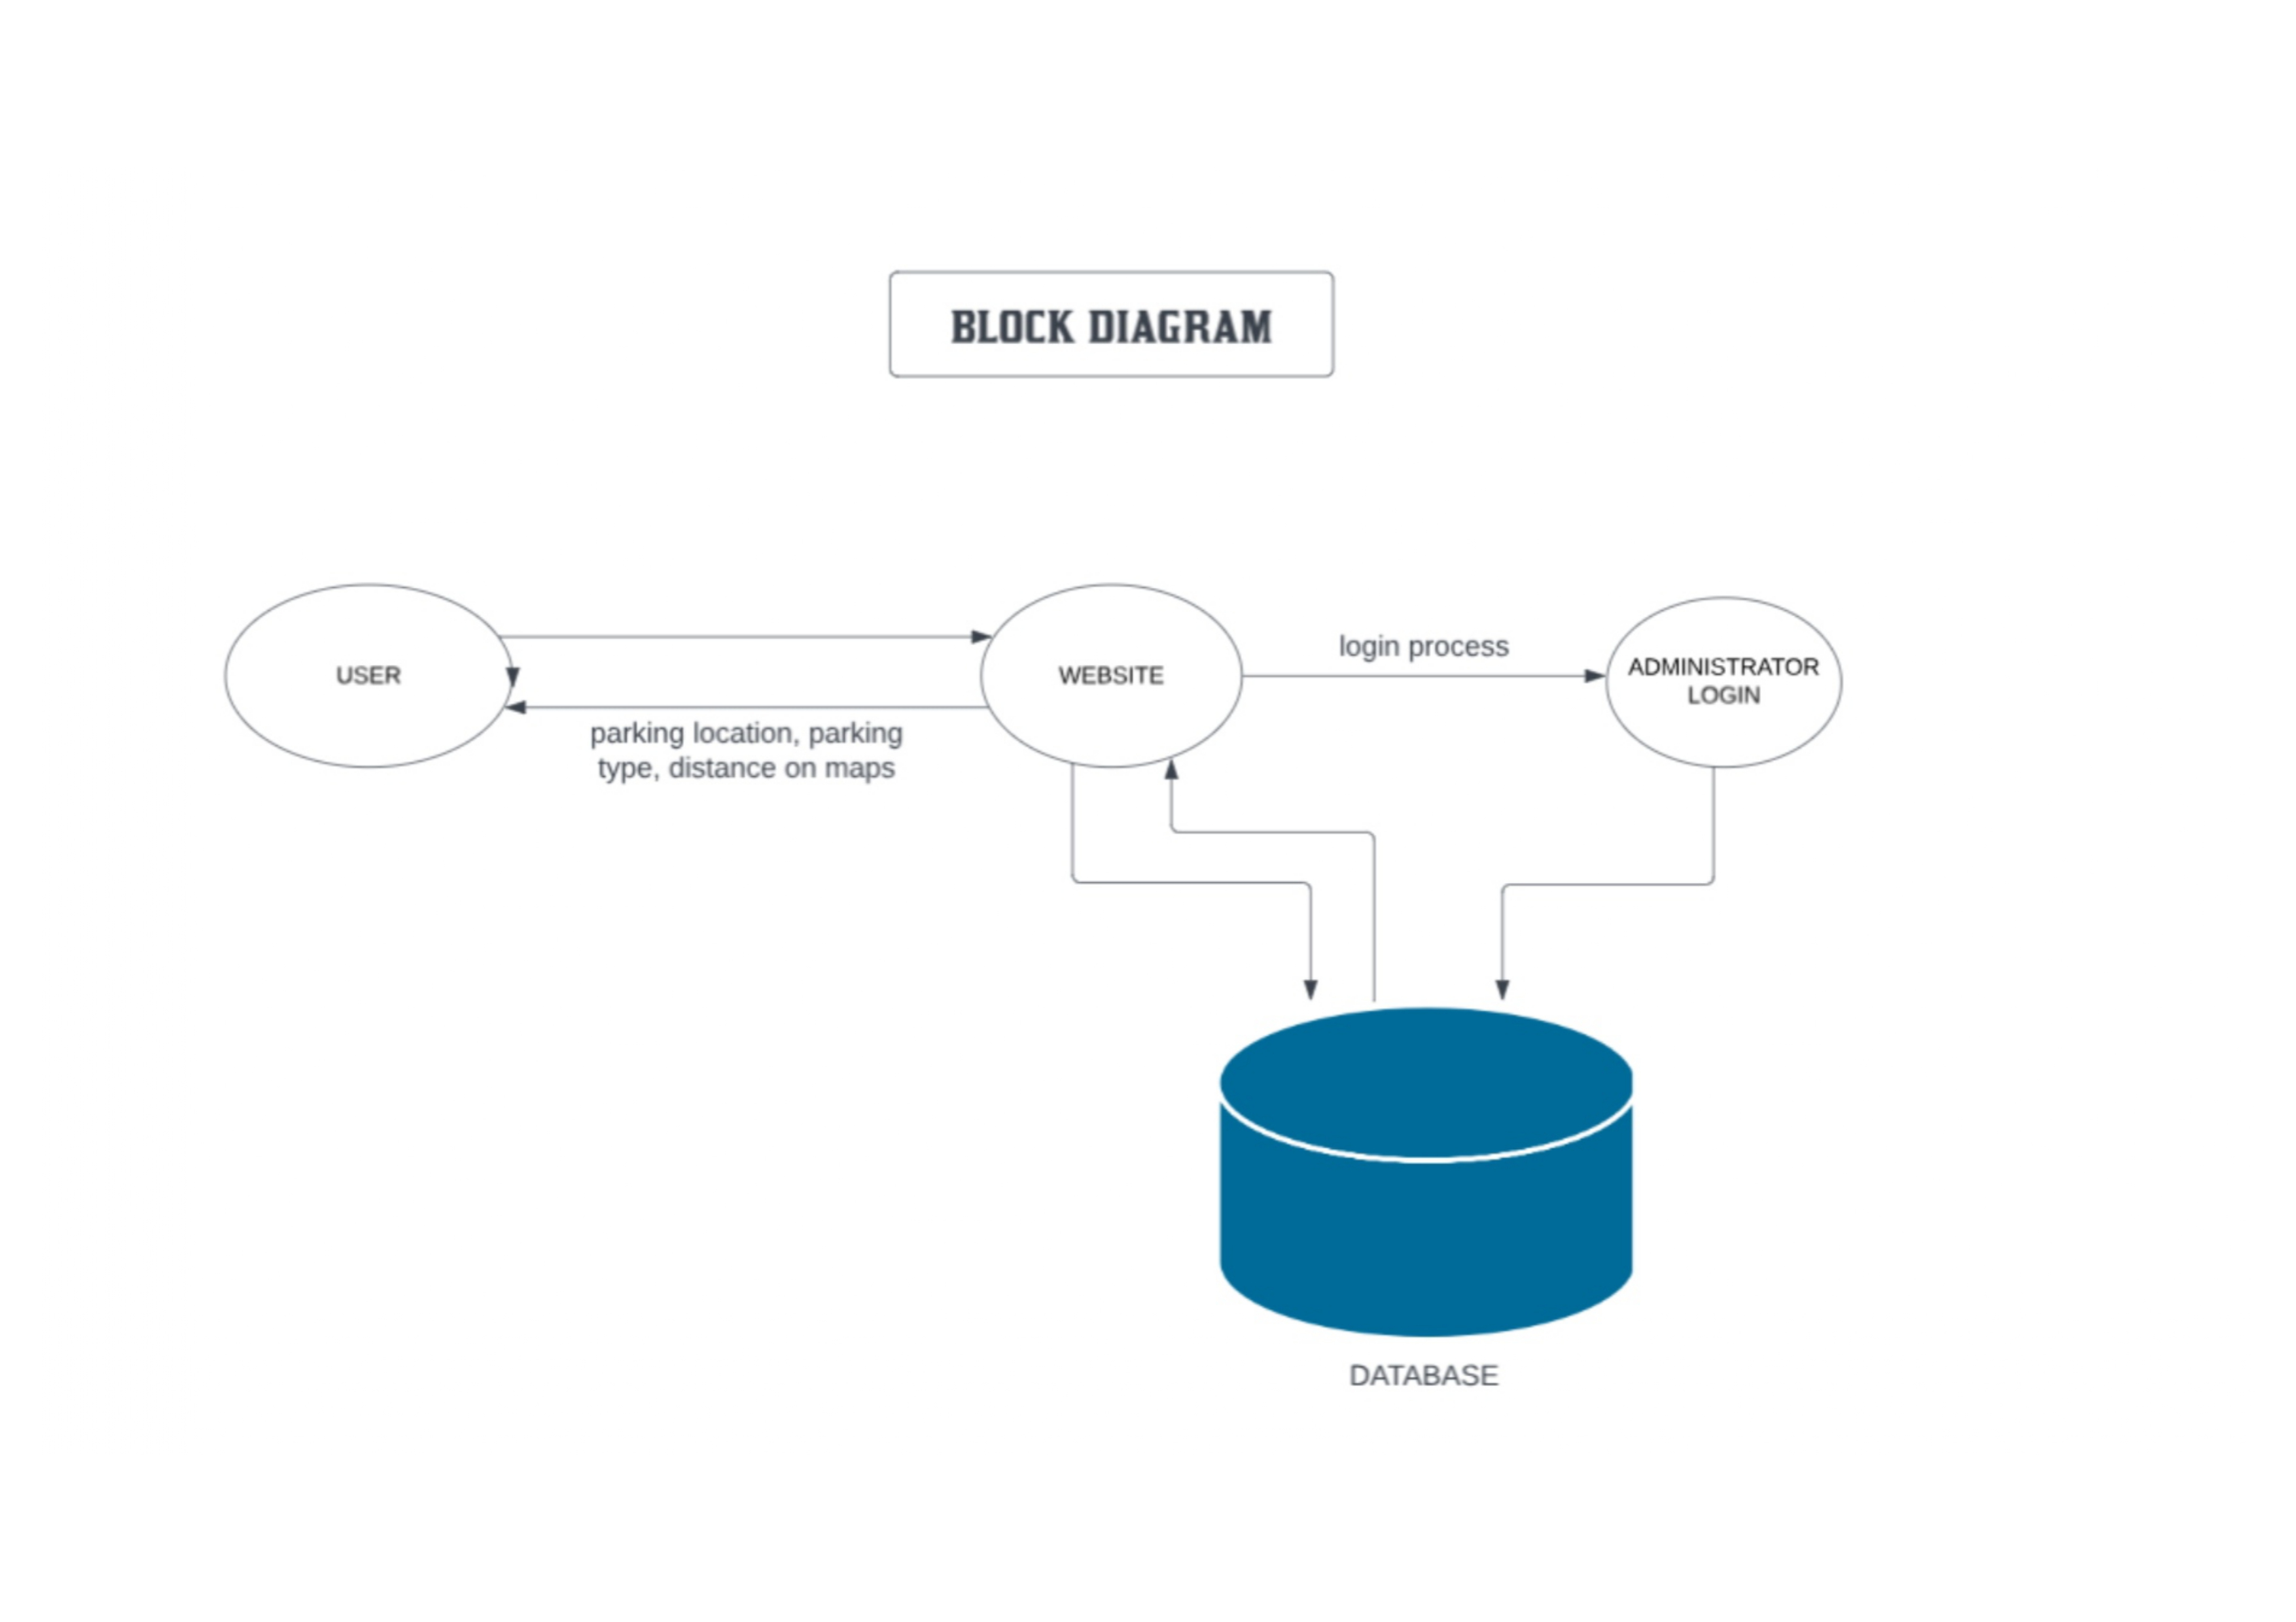
Block Diagram

Slide 6
Work done
Decided the work for projectees and given the work to the individuals according to their roles.
Discussed the problems that are being faced by the people in order to park their vehicles.
Planned the sequence of attributes in the website which makes it more convenient to use.
Started with the front end work.
The website is being designed in such a Structure that it can be used easily without getting confused.

Slide 7
Work done

Slide 8
Work done

Slide 9
Result & Discussion
Discussed about the problems which is faced by many of the people while parking their vehicle.
Discussed about database for keeping each and every details of the user secure in the website.
Discussed about the linking of database with the website.

Slide 10
Work – Plan
Months Activities | JAN’23 | FEB’23 | MAR’23 | APR’23
Project Reviews | √ | √
Component Identification & Selection |  | √
Designing |  | √ | √
coding |  |  | √
Experimental Analysis |  |  |  | √
Testing and Debugging |  |  |  | √
Preparation of Project Report
Thesis and Poster Submission

Slide 11
Conclusion (Till Date)
Urban Spotter aims to revolutionize the parking experience by providing a user-friendly platform that simplifiesnthe process of finding and reserving parking spaces.Through the integration of advanced technology,transparent cost structure,and user driven feedback,we strive to offer a seamless and efficient solution for users seeking convenient and stress-free parking.Urban Spotter aspires to redefine the way individuals approach and experience parking,making it a positive and integral part of their journey.Join us on this journey towards a future where parking is not just a necessity but a hassle-free and enjoyable experience.

Slide 12
References
Dribble;
https://dribbble.com/

Slide 13
Thank you !

